Slide 1
NOTIaPP!
Ian Alexandro Solis Cardona 1669117
Fernando De Luna Guardiola 1726916

Slide 2
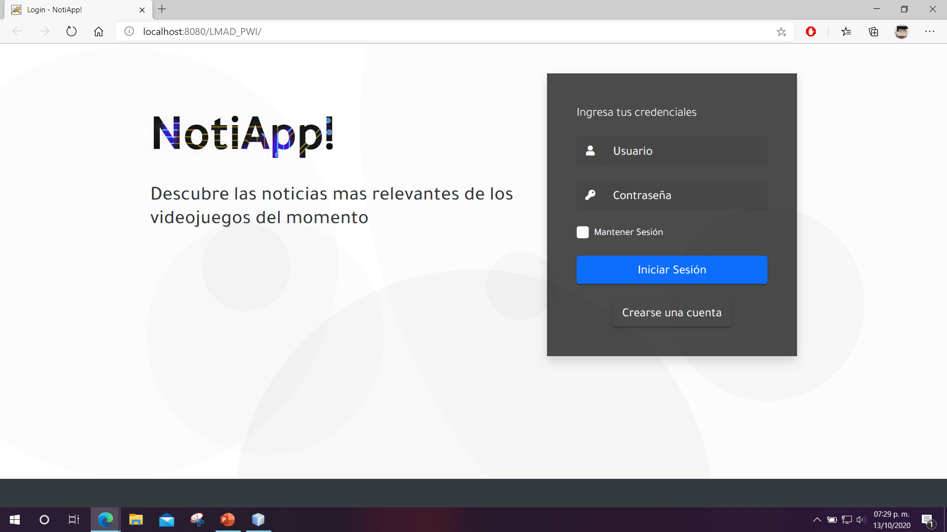
login

Slide 3
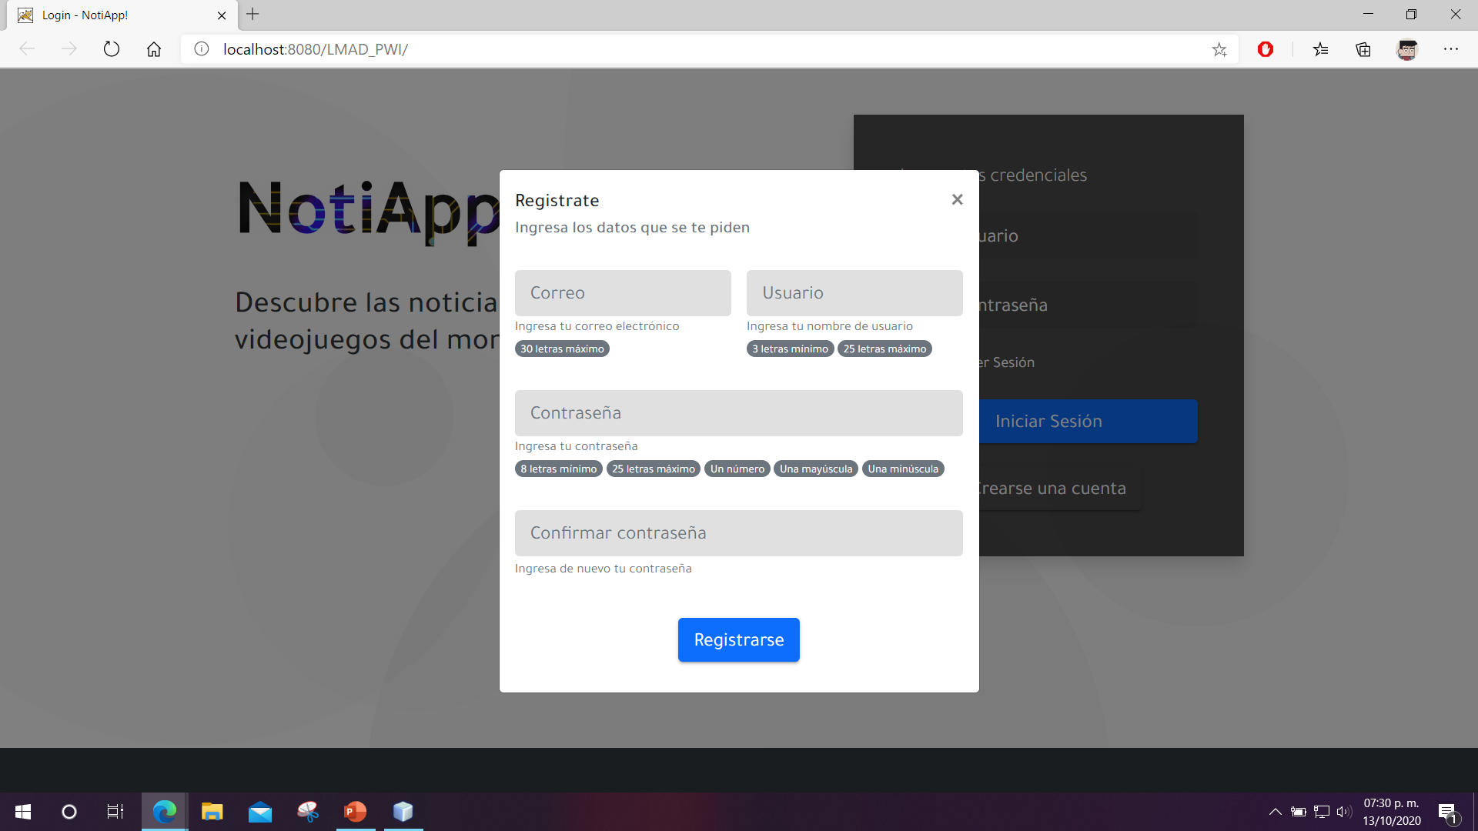
login

Slide 4
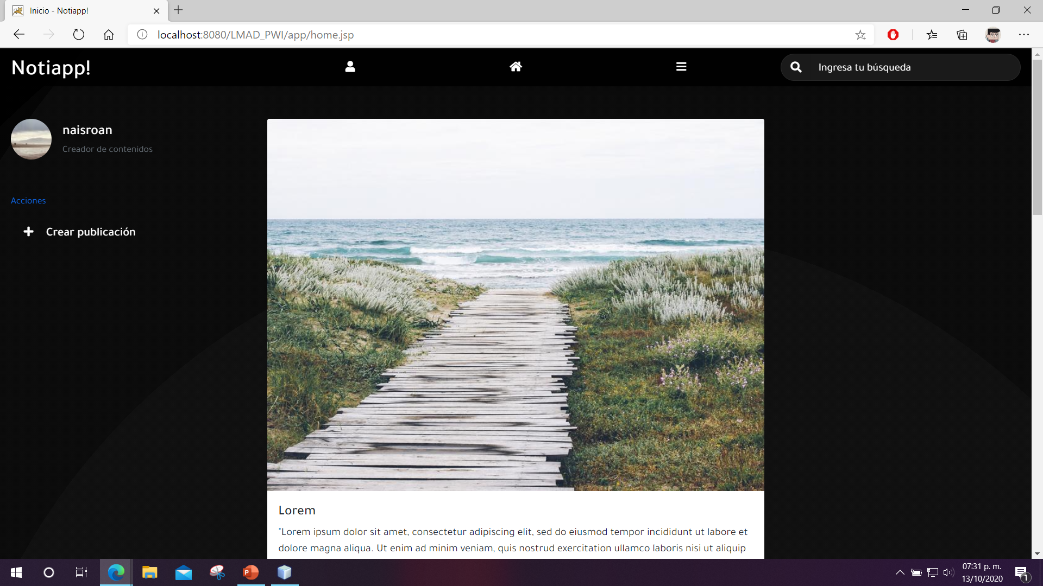
Home

Slide 5
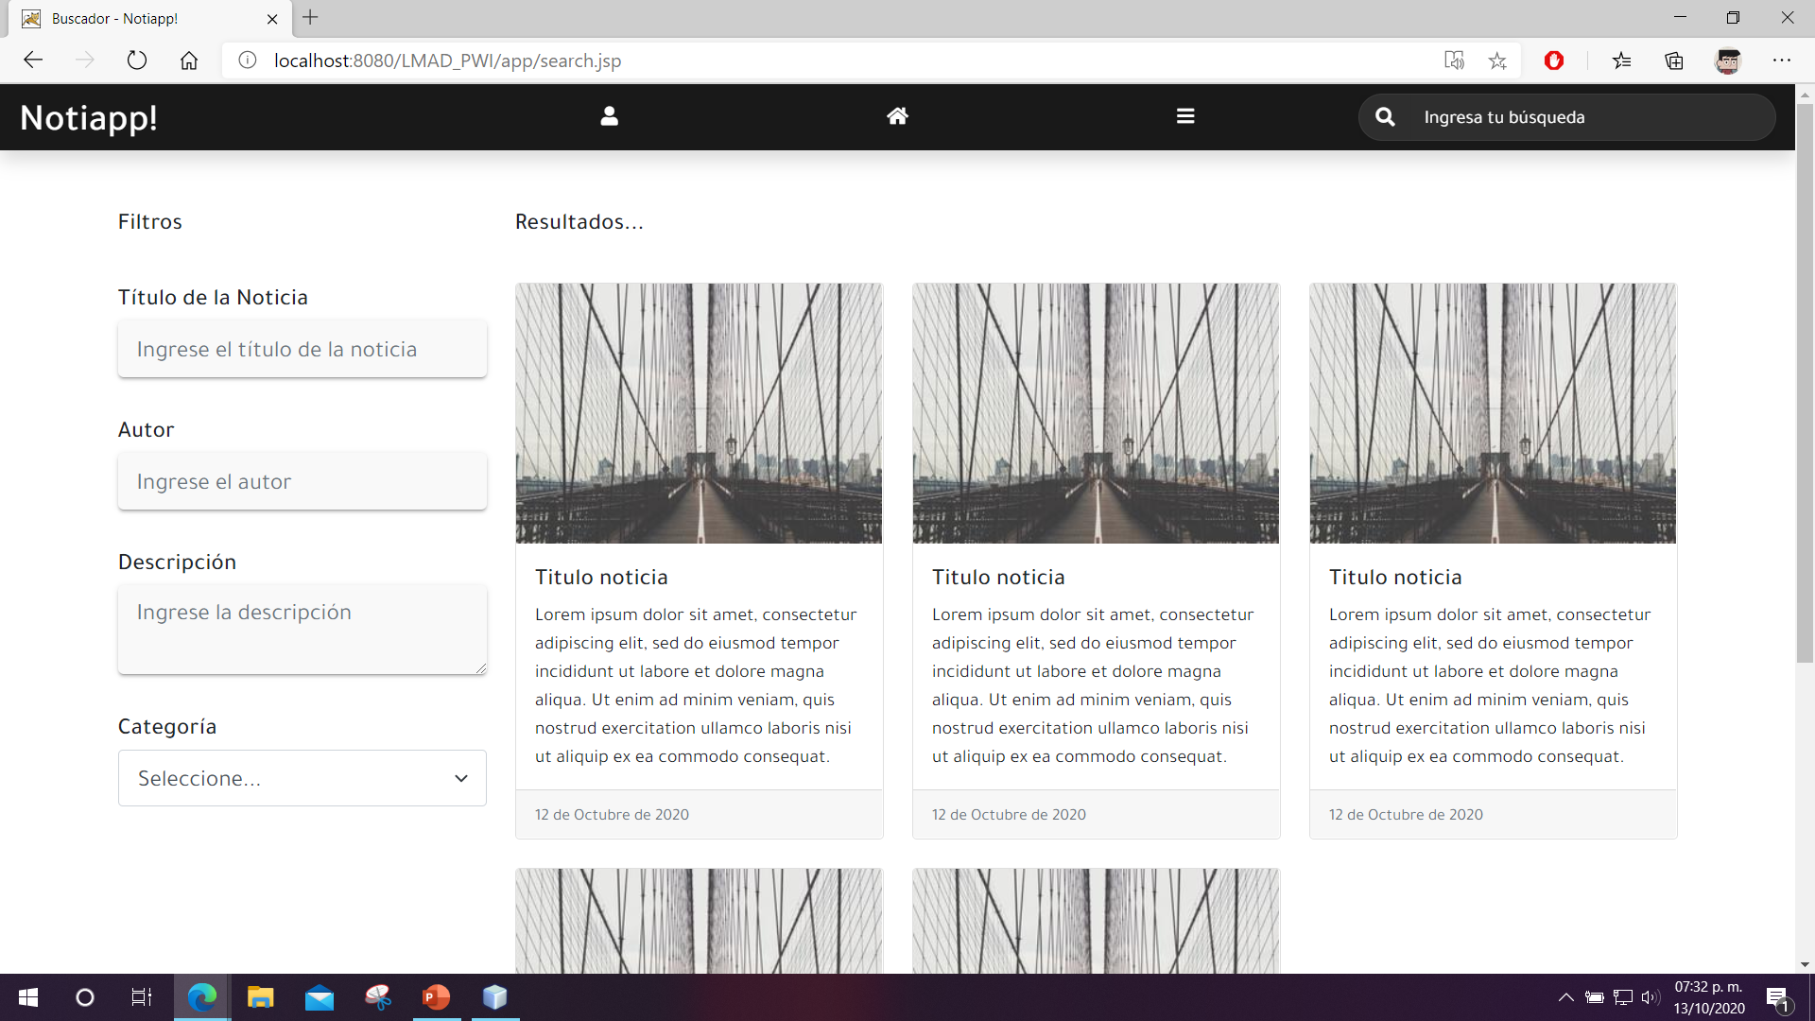
search

Slide 6
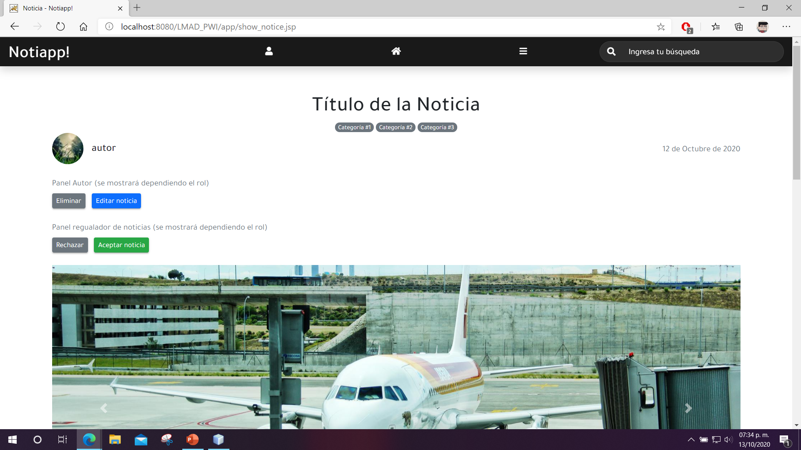
Show notice

Slide 7
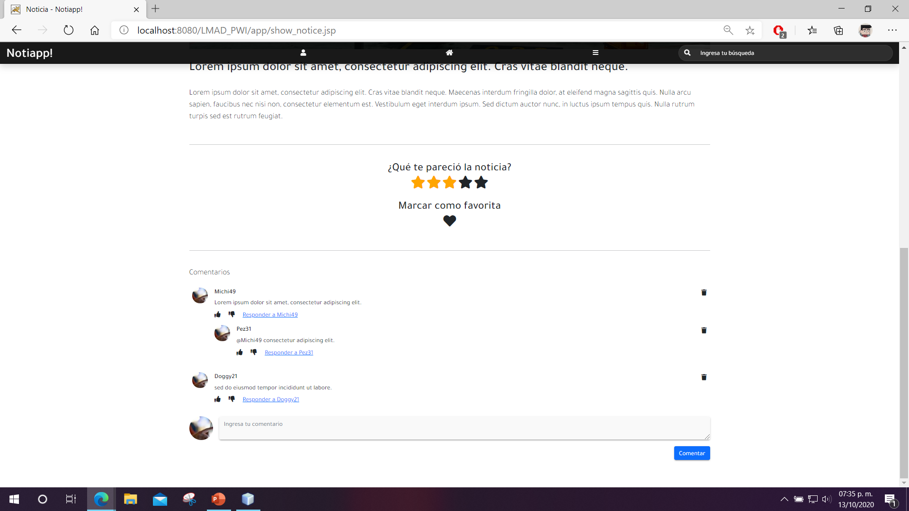
Show notice

Slide 8
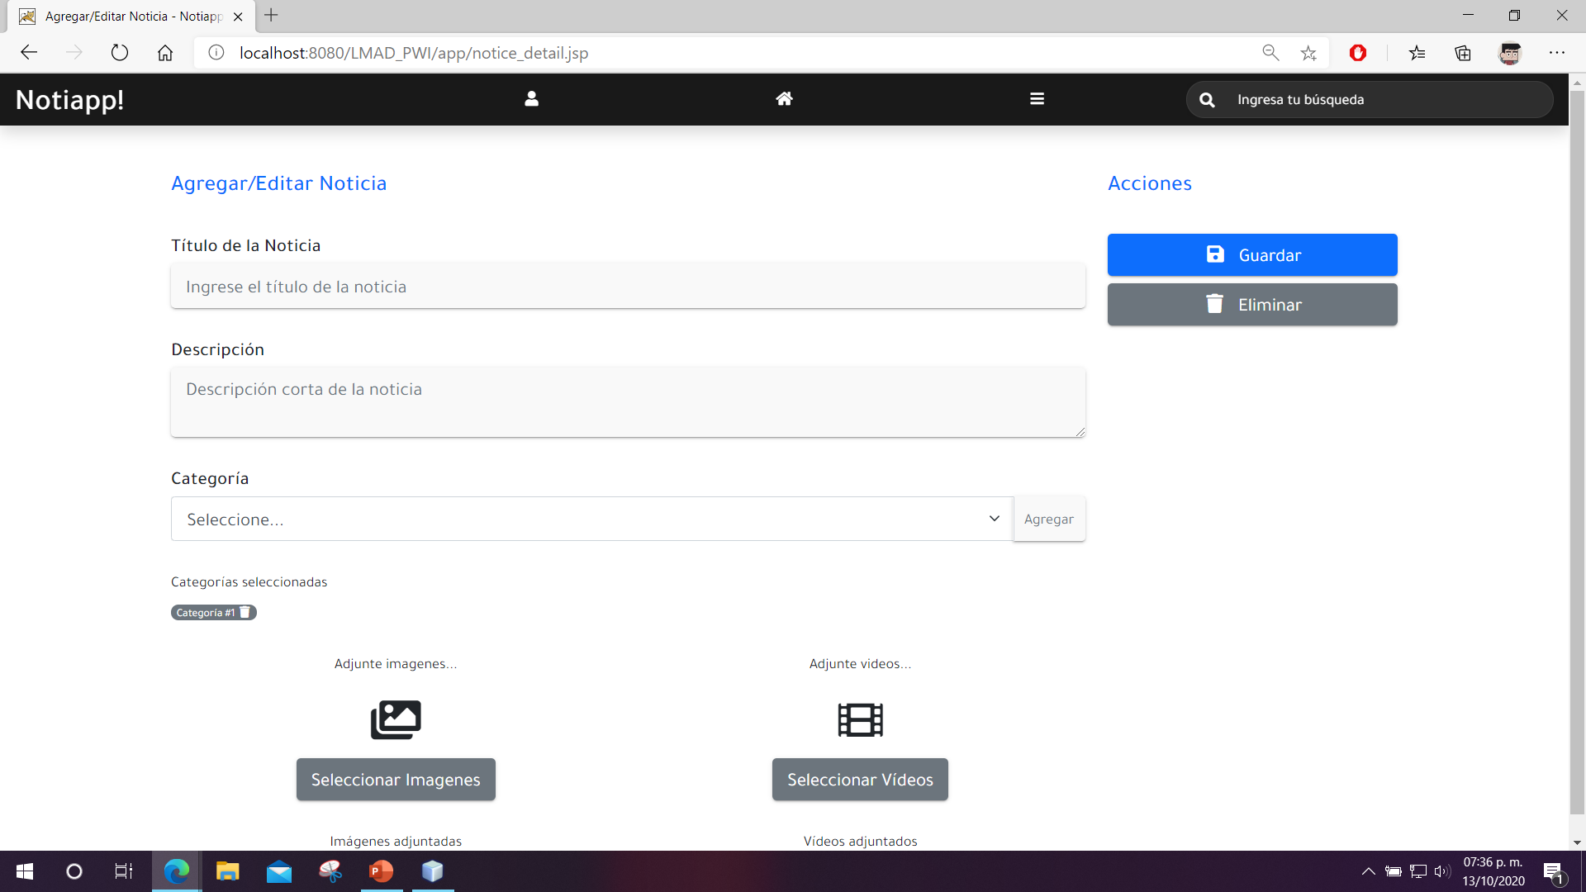
Notice detail

